Slide 1
Analyzing Blood Donation probabilities and number of possible donors
SIDHARTH K
MES20MCA-2049
PRODUCT OWNER-FEBIN AZIZ

Slide 2
TABLE OF CONTENTS
Introduction
Modules
Developing Environment
Data Flow Diagram
User story
Product backlog
Project plan
Sprint plan
Sprint1 actual

Slide 3
INTRODUCTION
Blood transfusion has critical importance for human survival in risky situations that may occur. The number of possible donors and blood donation probabilities can be determined by using machine learning approaches. When the need for blood occurs in the future, medical professionals can predict potential donors for blood supply. Machine learning algorithms can support the blood transfusion process using datasets. When it comes to human health, data analysis is carried out to help prevent situations that will have critical consequences. By looking at the results of the data analysis, donors who may donate blood can be detected. In order to make this process carried out as expected, accurate and complete access to existing records must be provided. Blood transfusion has been provided for many years.

Slide 4
MODULES
USERS
Registration
Login
View blood requirements
Accept blood request
Donate
Search blood
BLOOD BANK
Login
Add blood requirements
View request status
Update donation information
Probability check

Slide 5
DEVELOPING ENVIRONMENT
Hardware Requirements
Processor : Intel Pentium Core i3 and above, 64 bits
RAM : Min3GB RAM
HARD DISK : 10 GB
Software Requirements
OPERATING SYSTEM : WINDOWS 10
FRONT END : HTML, CSS, JAVASCRIPT
BACK END : Mysql
IDE USED : Jetbrains Pycharm, Android studio
TECHNOLOGY USED : PYTHON JAVA
FRAME WORK USED : Flask

Slide 6
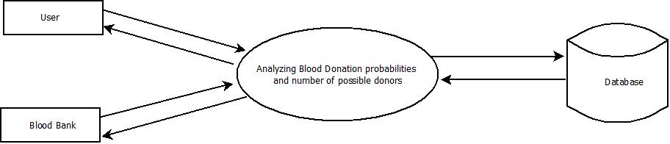
DATA FLOW DIAGRAM
Level 0

Slide 7
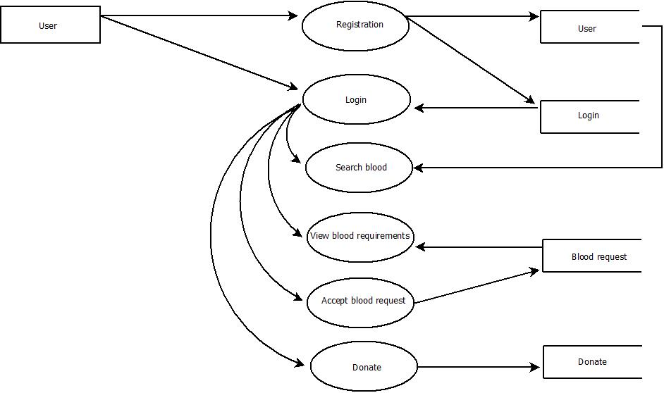
Level 1

Slide 8
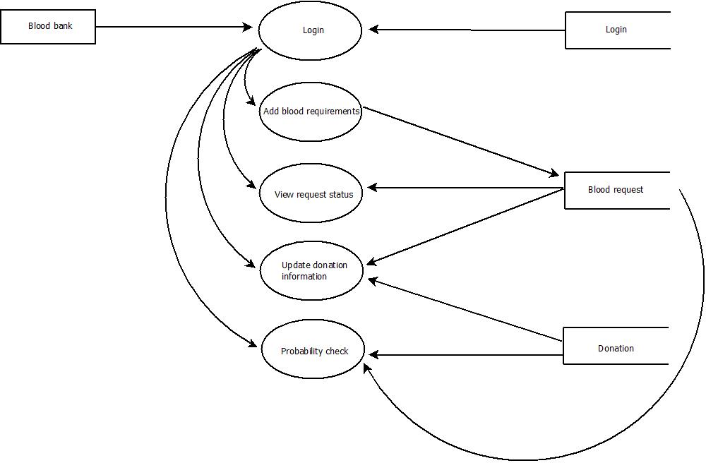
Level 2

Slide 9
USER STORY
UserStoryID | As a <type of user> | I want to | So that I can
1 | Blood Bank | login | login successful with correct username and password
2 | Blood Bank | Add blood requirement | Add request for required blood group
3 | Blood Bank | View request status | View blood requirement request status
4 | Blood Bank | Update donation | information Update request status to donation
5 | Blood Bank | Probability check | Checking probability of blood availability
6 | User | Registration | Register user by details
7 | User | Login | Login by using username and password
8 | User | Search blood | Search blood by group
9 | User | View blood requirements | View same blood group requirements
10 | User | Accept request | Accept blood request
11 | User | Donate | Donate blood

Slide 10
PRODUCT BACKLOG
User Story ID | Priority <High/Medium/Low> | Size (Hours) | Sprint <#> | Status <Planned/In progress/Completed> | Release Date | Release Goal
1 | Medium | 2 | 1 | Completed | 08/01/2022 | Table design
2 | High | 3 |  | Completed | 08/01/2022 | Form design
3 | High | 5 |  | Completed | 08/01/2022 | Basic coding
4 | High | 5 | 2 | Planned |  | Manage blood donation details
5 | Medium | 5 |  | Planned |  | Manage dataset.
6 | High | 5 | 3 | Planned |  | Analyzing blood donation probability
7 | medium | 5 |  | Planned |  | Machine learning
8 | Medium | 5 | 4 | Planned |  | Testing data
9 | High | 5 |  | Planned |  | Output generation

Slide 11
PROJECT PLAN
User Story ID | Task Name | Start Date | End Date | Days | Status
1 | Sprint 1 | 26/12/2021 | 28/12/2021 | 2 | Completed
2 |  | 29/12/2021 | 31/12/2021 | 3 | Completed
3 |  | 03/01/2021 | 08/01/2022 | 5 | Completed
4 | Sprint 2 | 09/01/2022 | 16/01/2022 | 8 | Planned
5 |  | 18/01/2022 | 22/01/2022 | 5 | Planned
6 | Sprint 3 | 23/01/2022 | 27/01/2022 | 5 | Planned
7 |  | 30/01/2022 | 05/02/2022 | 7 | Planned
8 | Sprint 4 | 06/02/2022 | 10/01/2022 | 5 | Planned
9 |  | 16/02/2022 | 19/02/2022 | 4 | Planned

Slide 12
SPRINT PLAN
Backlog Item | Status & completion date | Original estimate in hours | Day1 | Day2 | Day3 | Day4 | Day5 | Day6 | Day7 | Day8 | Day9 | Day10 | Day11 | Day12 | Day13 | Day14
User story #1,#2,#3 |  | hrs | hrs | hrs | hrs | hrs | hrs | hrs | hrs | hrs | hrs | hrs | hrs | hrs | hrs | hrs
Table design | 28/12/2021 | 2 | 1 | 1 | 0 | 0 | 0 | 0 | 0 | 0 | 0 | 0 | 0 | 0 | 0 | 0
Form design | 31/12/2021 | 3 | 0 | 0 | 0 | 1 | 1 | 1 | 0 | 0 | 0 | 0 | 0 | 0 | 0 | 0
Coding | 08/01/2021 | 5 | 0 | 0 | 0 | 0 | 0 | 0 | 0 | 0 | 0 | 1 | 1 | 1 | 1 | 1
User story #4,#5,#6,#7,#8
Manage blood donation details | 16/01/2022 | 5 | 1 | 1 | 0 | 1 | 0 | 1 | 0 | 1 | 0 | 0 | 0 | 0 | 0 | 0
Manage dataset. | 22/01/2022 | 5 | 0 | 0 | 0 | 0 | 0 | 0 | 0 | 0 | 0 | 1 | 1 | 1 | 1 | 1
Analyzing blood donation probability | 27/01/2022 | 5 | 1 | 1 | 1 | 1 | 1 | 0 | 0 | 0 | 0 | 0 | 0 | 0 | 0 | 0
Machine learning | 05/02/2022 | 5 | 0 | 0 | 0 | 0 | 0 | 0 | 0 | 1 | 0 | 1 | 1 | 1 | 0 | 1
Testing data | 10/01/2022 | 5 | 1 | 1 | 1 | 1 | 1 | 0 | 0 | 0 | 0 | 0 | 0 | 0 | 0 | 0
User story #9
Output generation | 19/02/2022 | 5 | 0 | 0 | 0 | 0 | 0 | 0 | 0 | 0 | 0 | 2 | 1 | 1 | 1 | 1
Total |  | 40 | 4 | 4 | 2 | 4 | 3 | 2 | 0 | 2 | 0 | 5 | 4 | 4 | 3 | 4

Slide 13
SPRINT 1 ACTUAL
Backlog Item | Status & completion date | Original estimate in hours | Day1 | Day2 | Day3 | Day4 | Day5 | Day6 | Day7 | Day8 | Day9 | Day10 | Day11 | Day12 | Day13 | Day14
User story #1,#2,#3 |  | hrs | hrs | hrs | hrs | hrs | hrs | hrs | hrs | hrs | hrs | hrs | hrs | hrs | hrs | hrs
Table design | 28/12/2021 | 3 | 1 | 1 | 0 | 0 | 0 | 0 | 0 | 0 | 0 | 0 | 0 | 0 | 0 | 0
Form design | 31/12/2021 | 2 | 0 | 0 | 0 | 1 | 1 | 1 | 0 | 0 | 0 | 0 | 0 | 0 | 0 | 0
Coding | 08/01/2021 | 5 | 0 | 0 | 0 | 0 | 0 | 0 | 0 | 0 | 0 | 1 | 1 | 1 | 1 | 1
User story #4,#5,#6,#7,#8
Manage blood donation details
Manage dataset.
Analyzing blood donation probability
Machine learning
Testing data
User story #9
Output generation
Total |  | 10 | 1 | 1 | 0 | 1 | 1 | 1 | 0 | 0 | 0 | 1 | 1 | 1 | 1 | 1

Slide 14
THANK YOU

